Slide 1
Questions this week
Unified Distributed Quantum Architecture
Developed and evaluated a communication-aware distributed architecture that integrates complementary optimization strategies .
Hardware Layer (IonQ)
High-rate Bell-pair generation
Fast photonic interconnects
Communication-aware execution
Control Layer (YOUTIAO)
Frequency-Division Multiplexing (FDM)
Time-Division Multiplexing (TDM)
Reduced communication contention
Network Layer (SwitchQNet)
Intelligent routing
Topology-aware scheduling
Congestion-aware resource allocation
Fast Interconnect Optimization Study
Investigated the impact of communication bandwidth on distributed quantum performance.
Analysis Performed
Effective entanglement latency analysis
Marginal-improvement analysis
Gradient-based operating-point selection
How much of the scalability bottleneck can be removed through communication-aware co-design and fast interconnect optimization?

Slide 2
Unified Distributed Quantum Architecture
Architecture | Communication Model | Key Characteristics
Direct (Slow) | Point-to-point communication | Limited bandwidth, higher communication latency
Direct (Fast) | High-speed direct links | Reduced latency and synchronization overhead
Monolithic (Slow) | Single large processor | High crosstalk, routing congestion, slower operation execution
Monolithic (Fast) | Accelerated monolithic processor | Faster operations but retains scalability limitations
Distributed Unified (Slow) | IonQ + YOUTIAO + SwitchQNet with slow interconnect | Advanced routing and scheduling, but communication bottleneck remains
Distributed Unified (Fast) | IonQ + YOUTIAO + SwitchQNet + Fast Interconnect | Multiplexing, intelligent routing, high-rate Bell-pair generation, minimized communication overhead
Evaluate how progressively adding communication-aware optimizations affects scalability, logical error, and execution depth. Scalability is achieved not by a single optimization, but through the combination of fast communication, intelligent routing, and communication-aware scheduling.
Notes:
"The purpose of this study is not simply to compare architectures. Instead, we progressively add communication optimizations—from direct communication to a fully unified distributed framework. The final Distributed Unified Fast architecture combines IonQ-inspired multiplexing, YOUTIAO scheduling, SwitchQNet routing, and high-rate Bell-pair generation. This allows us to evaluate which communication mechanisms contribute most significantly to scalability."

Slide 3
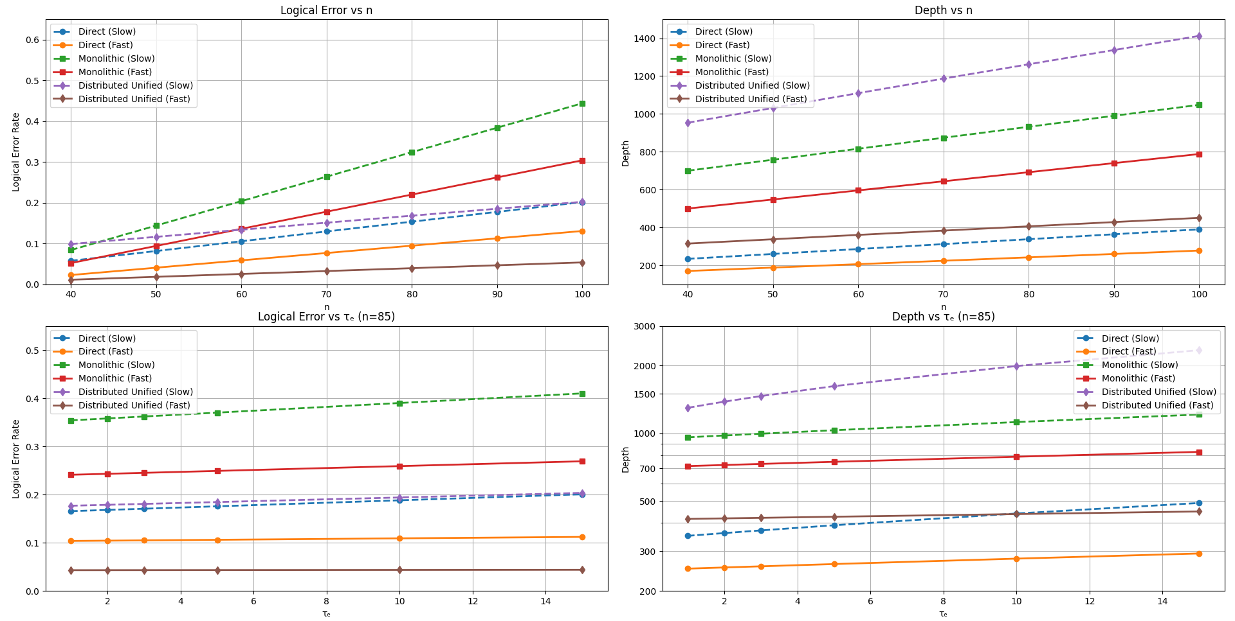
Logical Error Vs n
Why Does Distributed Unified (Fast) Perform Best?​
Communication Bottlenecks Are Reduced at Multiple Layers​
The architecture integrates:​
IonQ-inspired multiplexing, which increases Bell-pair utilization efficiency. ​
YOUTIAO FDM/TDM scheduling, which reduces communication contention and crosstalk. ​
SwitchQNet intelligent routing, which minimizes queueing and routing delays. ​
High-rate Bell-pair generation, which reduces entanglement waiting time. ​
Direct (Fast)​
Second-best performance. ​
Benefits from high-speed communication links. ​
Avoids complex routing overhead. ​
However, lacks adaptive scheduling and multiplexing optimizations. ​
Direct (Slow)​
Error increases steadily with system size. ​
Limited bandwidth results in longer waiting times and increased decoherence. ​
Distributed Unified (Slow)​​
Advanced routing and scheduling are present. ​​
However, communication remains constrained by slow interconnects. ​​
Queueing delays eventually dominate performance. ​​
Monolithic Architectures​​
Highest logical error growth. ​​
Increased crosstalk, control complexity, and routing congestion accumulate as system size increases. ​​
Scalability deteriorates rapidly at larger qubit counts.​​
​
The Distributed Unified (Fast) architecture demonstrates that joint optimization of communication, routing, scheduling, and Bell-pair generation can substantially improve scalability and error resilience in distributed quantum computing systems.
Notes:
"The key result from this graph is that scalability is not achieved simply by distributing computation. Scalability emerges when communication overhead is actively managed through fast interconnects, intelligent routing, and multiplexed resource allocation."

Slide 4
Depth Vs n
Why Does Distributed Unified (Fast) Perform Well?
Although communication is required, the unified architecture combines: IonQ-inspired multiplexing + YOUTIAO FDM/TDM scheduling + SwitchQNet routing optimization + Fast Bell-pair generation
These mechanisms reduce: Queueing delays, Waiting times, Routing congestion and Resource contention
As a result, communication overhead remains bounded, allowing the architecture to maintain significantly lower depth than conventional distributed systems.
Why Does Direct (Fast) Have the Lowest Depth?
The Direct architecture executes operations locally and therefore avoids the communication overhead associated with distributed execution.
Unlike distributed systems, it does not require: Bell-pair generation + Quantum teleportation + Inter-node synchronization + Routing of remote operations
Therefore, DepthDirect≈DepthLocal and the overall circuit depth grows primarily due to the computational workload rather than communication delays.
Direct (Fast) achieves the lowest circuit depth.
Distributed Unified (Fast) achieves the second-lowest depth.
Monolithic architectures exhibit substantially larger depths.
Distributed Unified (Slow) shows the largest depth growth.
Fast communication infrastructure combined with intelligent routing and scheduling allows distributed quantum systems to approach the efficiency of direct architectures while retaining the scalability benefits of modular execution.

Slide 5
Logical Error Vs Entanglement Latency
The Distributed Unified (Fast) architecture maintains the lowest and most stable logical error rate across the entire range of entanglement latency values.
The slope of the curve is nearly flat, indicating minimal sensitivity to increasing communication delay.
The architecture combines: High-rate Bell-pair generation + IonQ-inspired communication multiplexing + YOUTIAO FDM/TDM scheduling + SwitchQNet intelligent routing
Together these mechanisms reduce Waiting time for entanglement resources, Communication congestion, Queue build-up and Synchronization overhead.
Direct Fast​
Also exhibits low sensitivity to increasing τe because high-bandwidth communication minimizes latency overhead.​
​
Direct Slow​​
Logical error gradually increases as longer communication delays expose qubits to additional decoherence.​​
Distributed Unified Slow
Although advanced routing and multiplexing are available, slower interconnects increase queueing delays and waiting time, resulting in higher logical error.
Monolithic Architectures​
Show the highest logical error rates due to:​
Control complexity ​
Crosstalk accumulation ​
Routing contention ​
Increased qubit interaction overhead
This suggests that scalable distributed quantum systems require not only fast communication links but also intelligent routing, multiplexing, and resource scheduling to maintain logical stability as network latency increases.
Notes:
“The nearly flat Distributed Unified Fast curve indicates that communication overhead has been effectively decoupled from logical error growth, making the architecture substantially more robust to increasing entanglement latency than conventional distributed or monolithic approaches.”

Slide 6
Depth Vs Entanglement Latency
As entanglement latency (τₑ) increases, all architectures experience an increase in execution depth. However, the rate of increase varies significantly across architectures.
Distributed Unified (Fast)​
Exhibits only a small increase in depth despite increasing τₑ. ​
IonQ multiplexing, YOUTIAOFDM/TDM scheduling, and SwitchQNet routing effectively hide communication delays. ​
Maintains bounded communication overhead even as entanglement latency grows.
Distributed Unified (Slow)​
Experiences the steepest depth growth among distributed configurations. ​
Queueing delays and slower Bell-pair generation dominate execution time. ​
Communication overhead becomes the primary contributor to circuit depth.
Direct (Slow)​​
Shows moderate depth growth. ​​
Communication latency accumulates as τₑ increases. ​​
Remains more efficient than distributed architectures due to the absence of inter-node routing.​
Direct (Fast)​
Maintains the lowest circuit depth across the entire τₑ range. ​
Benefits from high-speed communication and minimal routing overhead. ​
Least sensitive to increasing entanglement latency. ​
Monolithic Architectures
Depth remains significantly larger than Direct Fast and Distributed Unified Fast.
Scaling is limited by control complexity, routing contention, and increasing scheduling overhead within a single processor.
Fast communication infrastructure is essential for scalable distributed quantum computing. When combined with intelligent routing, multiplexing, and resource scheduling, distributed architectures can maintain near-linear depth scaling even under increasing entanglement latency.
Notes:
The graph demonstrates that:
Depth∝Computation+Communication+SynchronizationDepth. Architectures with efficient communication management experience only modest depth growth, whereas architectures with slower interconnects suffer significant execution overhead.

Slide 7
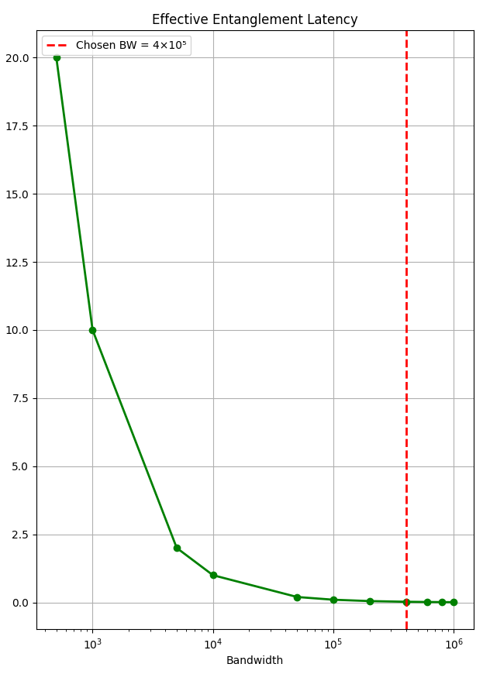
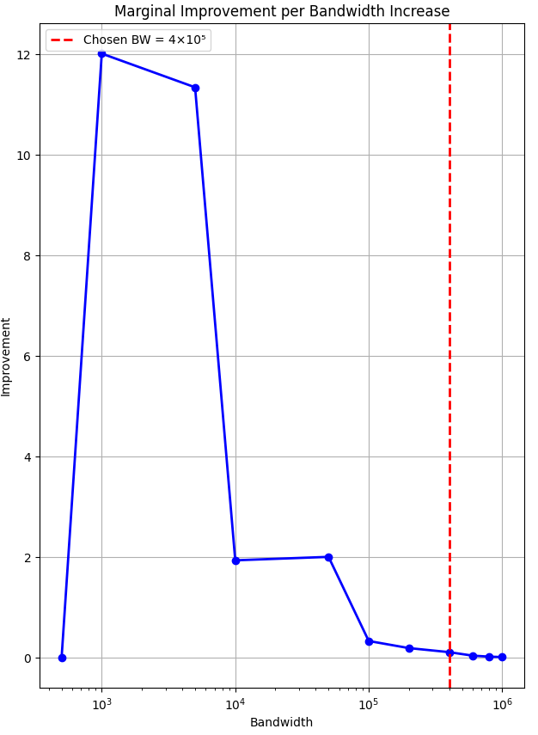
Why are slopes different
Effective Entanglement Latency
The latency curve measures the actual communication delay experienced by the quantum network.
The relationship between bandwidth and latency is
Τeff∝1\BW.
As bandwidth increases Bell-pair delivery becomes faster + Communication delay decreases + Routing overhead is reduced.
This produces a smooth hyperbolic decay, where latency falls rapidly at first and then gradually approaches zero.
Marginal Improvement
The marginal improvement curve measures Δτeff
the reduction in latency obtained from each additional increase in bandwidth.
Instead of measuring latency itself, it measures the benefit gained from adding more bandwidth.
As bandwidth increases communication bottleneck is progressively removed and each new bandwidth increment provides a smaller latency reduction.
The latency curve tells us how much delay remains, whereas the marginal improvement curve tells us how much additional benefit can still be obtained. Therefore, latency continues to decrease smoothly, and the benefit of additional bandwidth decreases rapidly. This is why the slopes of the two curves are fundamentally different.
Notes:
"The latency graph measures the absolute communication delay, so it decreases smoothly as bandwidth increases. The marginal improvement graph measures the benefit obtained from each additional bandwidth increment. Once communication is no longer the dominant bottleneck, adding more bandwidth produces very little extra benefit. Therefore, the latency curve remains smooth while the marginal improvement curve drops sharply and approaches zero."

Slide 8
Gradient Analysis
Bandwidth Interval | Gradient
500 → 1000 | −2.0 × 10⁻²
1000 → 5000 | −2.0 × 10⁻³
5000 → 10000 | −2.0 × 10⁻⁴
10000 → 50000 | −2.0 × 10⁻⁵
50000 → 100000 | −2.0 × 10⁻⁶
100000 → 200000 | −5.0 × 10⁻⁷
200000 → 400000 | −1.25 × 10⁻⁷
400000 → 600000 | −4.5 × 10⁻⁸
600000 → 800000 | −2.0 × 10⁻⁸
800000 → 1000000 | −1.0 × 10⁻⁸
At low bandwidth values, the gradient magnitude is large.
Small increases in bandwidth produce substantial reductions in entanglement latency.
As bandwidth increases, the gradient approaches zero.
The latency curve becomes nearly horizontal.
Around BW=4×10^5, the system enters a saturation regime, where further bandwidth increases produce only negligible reductions in effective entanglement latency.
Therefore:
Most communication bottlenecks have already been removed.
Additional bandwidth provides minimal performance gain.
Other factors (routing, scheduling, memory waiting, processing overhead) become dominant.
The near-zero gradient at BW=4×10^5 identifies the knee of the curve and represents the optimal trade-off between communication performance and resource utilization.
Notes:
"Initially, bandwidth is the dominant limiting factor, which is why the gradient is large. As bandwidth increases, the communication latency drops rapidly. However, beyond 4×1054\times10^54×105, the gradient becomes almost zero, indicating that the network has already captured most of the achievable latency reduction. At this point, allocating additional bandwidth becomes inefficient because the system transitions into a diminishing-returns regime. This is why 4×1054\times10^54×105 was selected as the operating point."

Slide 9
Why Choose BW=4×10^5
Effective Entanglement Latency Saturates
The effective entanglement latency decreases rapidly at low bandwidth values but approaches a near-constant minimum beyond BW=4×10^5
Below 4×10^5 = significant latency reduction
Above 4×10^5 = negligible additional improvement
Marginal Improvement Approaches Zero
The marginal improvement curve shows that the performance gain obtained from additional bandwidth decreases sharply after the knee point.
At BW≈4×10^5 the improvement per additional bandwidth increment becomes extremely small.
Gradient Analysis Indicates Saturation
The gradient becomes nearly zero around 4×10^5 indicating that the latency curve has entered the saturation region.
BW=4×10^5 was selected because it lies at the knee of the latency curve, where communication latency is already near its minimum, marginal improvement is negligible, the gradient approaches zero and the bandwidth allocation increases resource cost without meaningful performance gains

Slide 10
Key Findings
Communication Emerges as the Primary Scalability Bottleneck
As quantum operations become faster, the relative contribution of communication—including Bell-pair generation, routing, synchronization, and queueing—surpasses computation, making communication the dominant factor governing distributed quantum system performance.
Multi-Layer Co-Design Significantly Improves Distributed Execution
The integration of IonQ-inspired multiplexing, YOUTIAO scheduling, and SwitchQNet routing substantially reduces logical error growth and execution depth compared to conventional distributed and monolithic architectures.
Fast Communication Infrastructure Suppresses Entanglement-Latency Sensitivity
High-rate Bell-pair generation and efficient communication pathways reduce the dependence of logical error and circuit depth on entanglement latency τe, resulting in more stable and predictable system behavior.
BW=4×10^5 Represents an Efficient Operating Point
Gradient analysis, marginal-improvement analysis, and latency saturation behavior consistently indicate that
BW=4×10^5 lies near the knee of the bandwidth–latency curve, where most communication benefits have already been realized while avoiding unnecessary resource allocation.
Bandwidth Exhibits a Diminishing-Returns Regime
Increasing bandwidth initially provides substantial reductions in effective entanglement latency and routing delay. However, beyond a critical operating region, communication is no longer the dominant bottleneck and further bandwidth increases yield progressively smaller performance gains.
Scalability in distributed quantum computing is achieved not by increasing computational resources alone, but by jointly optimizing communication speed, routing intelligence, and resource management across multiple architectural layers.

